Slide 1
TNSDC - GENERATIVE AI FOR ENGINEERING
Final project
MEGHANA.G
(311521104027)

Slide 2
Image Caption Generator using CNN and LSTM

Slide 3
AGENDA
Introduction
Problem Statement
Project Overview
End Users
Solution and Value Proposition
The Wow in Your Solution
Key Features
Modelling
Results
Conclusion

Slide 4
INTRODUCTION
Image captioning is a challenging task in computer vision that involves generating descriptive and contextually relevant captions for images. This project aims to develop an automated solution for generating captions for images using deep learning techniques. By combining Convolutional Neural Networks (CNNs) for image feature extraction and Long Short-Term Memory (LSTM) networks for sequence modeling, our solution can understand the content of images and generate human-like captions. The project utilizes the Flickr8K dataset, which contains a large collection of images along with corresponding textual descriptions.

Slide 5
PROBLEM STATEMENT
Generating accurate and relevant captions for images is a challenging task in computer vision.
The goal is to develop a system that can automatically generate captions for images, improving accessibility and understanding of visual content.
Existing approaches often struggle to produce captions that capture the essence of visual content effectively.
Challenges include understanding the semantics of images, translating visual features into coherent language, and maintaining relevance and coherence in generated captions.
Additionally, ensuring that generated captions are diverse, descriptive, and grammatically correct poses further challenges.

Slide 6
Project Overview
The project focuses on developing an automated system capable of generating descriptive captions for images.
Leveraging deep learning techniques, the system combines Convolutional Neural Networks (CNNs) and Long Short-Term Memory (LSTM) networks to understand visual content and produce captions.
The model is trained on the Flickr8K dataset, which contains images along with corresponding textual descriptions.

Slide 7
End Users
1. Content Creators:
Bloggers, journalists, social media influencers, and marketers who rely on visual content for storytelling.
The image caption generator can assist them in quickly and efficiently adding descriptive captions to their images, enhancing accessibility.

Slide 8
End Users
2.Researchers:
Researchers in the fields of computer vision, natural language processing, and multimodal learning.
The image caption generator serves as a valuable tool for studying and advancing techniques in understanding and generating textual descriptions from visual content.

Slide 9
End Users
3. General Users:
Anyone who consumes visual content on digital platforms.
The generated captions enhance the user experience by providing additional context and information about images, enriching the overall browsing experience.

Slide 10
Solution and Value Proposition
Solution: Image Caption Generator using CNN and LSTM
Value Proposition:
Efficiency: Our solution automates the process of generating descriptive captions for images, saving time and effort for content creators.
Accessibility: Provides valuable context and information about visual content, enhancing accessibility for visually impaired individuals.
Enhanced Engagement: Captions add depth and storytelling elements to images, increasing engagement and interaction with visual content.
Versatility: The image caption generator can be integrated into various applications and platforms, catering to diverse user needs.

Slide 11
The Wow in Your Solution
Integration of CNNs and LSTMs: This integration enables the model to understand visual content and generate contextually relevant captions.
Pretrained GloVe Embeddings: We incorporate pre-trained GloVe word embeddings to enhance the semantic understanding of textual descriptions. This improves the model's ability to generate captions that are not only descriptive but also semantically meaningful.
The Wow Factor:
Our solution stands out due to its robust architecture, seamless integration of deep learning techniques, and user-friendly interface.
It offers an efficient and effective way to generate descriptive captions for images, catering to the diverse needs of users across different domains.

Slide 12
Key Features
CNN-LSTM Architecture: Utilizes a combination of Convolutional Neural Networks (CNNs) for image feature extraction and Long Short-Term Memory (LSTM) networks for sequence modeling.
Pretrained GloVe Embeddings: Incorporates pre-trained GloVe word embeddings to enhance the semantic understanding of textual descriptions.
Data Preprocessing: Cleans and preprocesses textual descriptions, generates vocabulary, and prepares images for feature extraction.
Model Training: Optimizes model parameters using training data to learn the relationship between visual features and textual descriptions.

Slide 13
Modelling
CNN-LSTM Architecture:
Combines Convolutional Neural Networks (CNNs) for image feature extraction and Long Short-Term Memory (LSTM) networks for sequence modeling.
CNN extracts visual features from images, while LSTM generates captions based on these features.
Embeddings Integration:
Integrates pre-trained GloVe word embeddings to enhance the semantic understanding of textual descriptions.
Embeddings are used to represent words in the vocabulary, improving the model's language understanding.

Slide 14
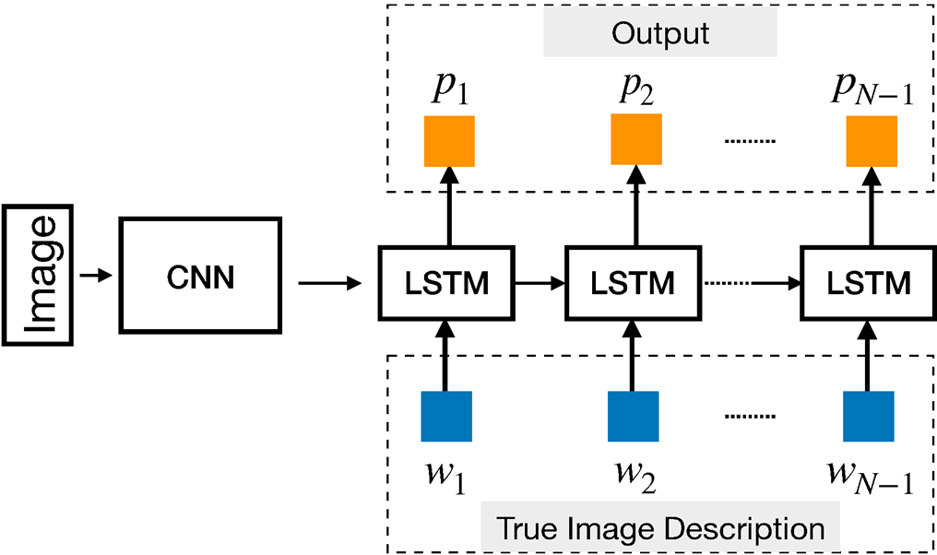
Modelling

Slide 15
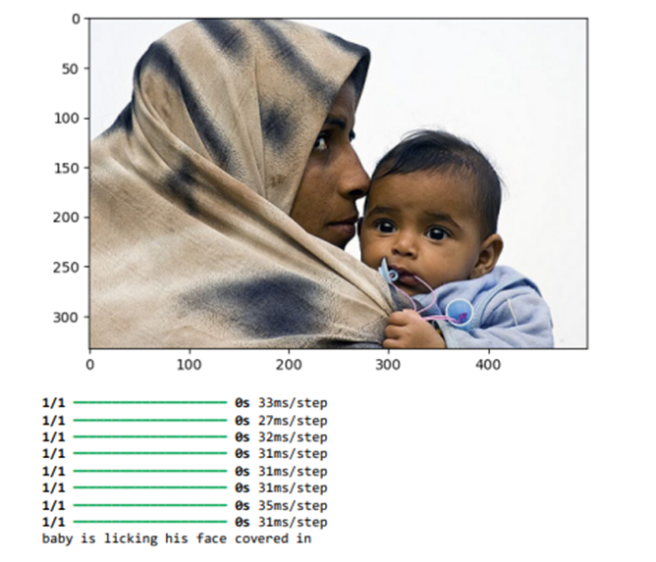
Results

Slide 16
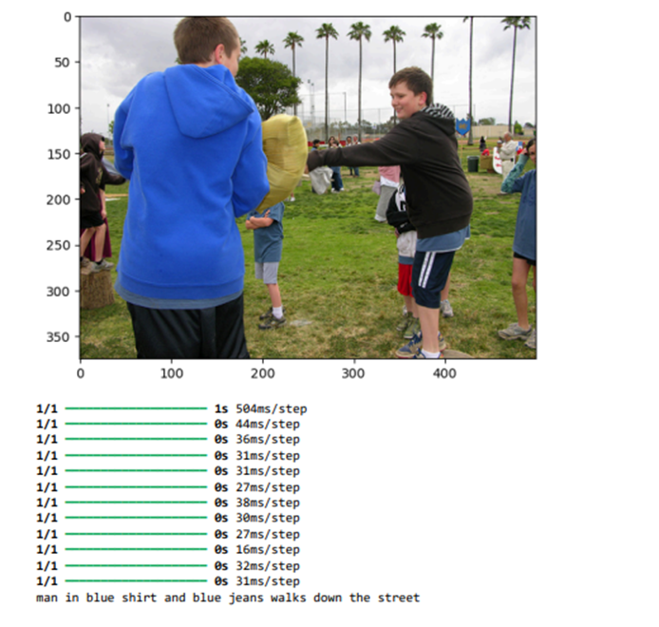
Results

Slide 17
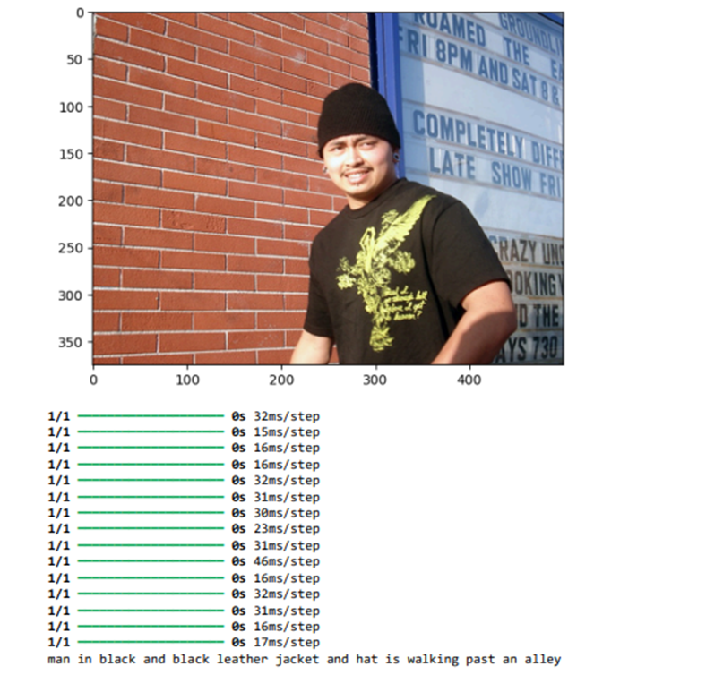
Results

Slide 18
CONCLUSION
In conclusion, the development of an image caption generation system using CNN and LSTM models with Flickr data has demonstrated promising results. The system successfully automates the process of generating descriptive captions for images, enhancing the accessibility and user experience of visual content across various domains.
Through the integration of Convolutional Neural Networks (CNNs) for feature extraction from images and Long Short-Term Memory (LSTM) networks for sequence generation, the proposed solution effectively learns the relationships between visual content and textual descriptions.

Slide 19
THANK YOU
Meghana .G
III year CSE
311521104027

